Slide 1
Common interaction difficulties
Jeff Leek
@jtleek
www.jtleek.com

Slide 2
Lack of interaction
Identify the problem
Take a more active role
Move personnel if necessary

Slide 3
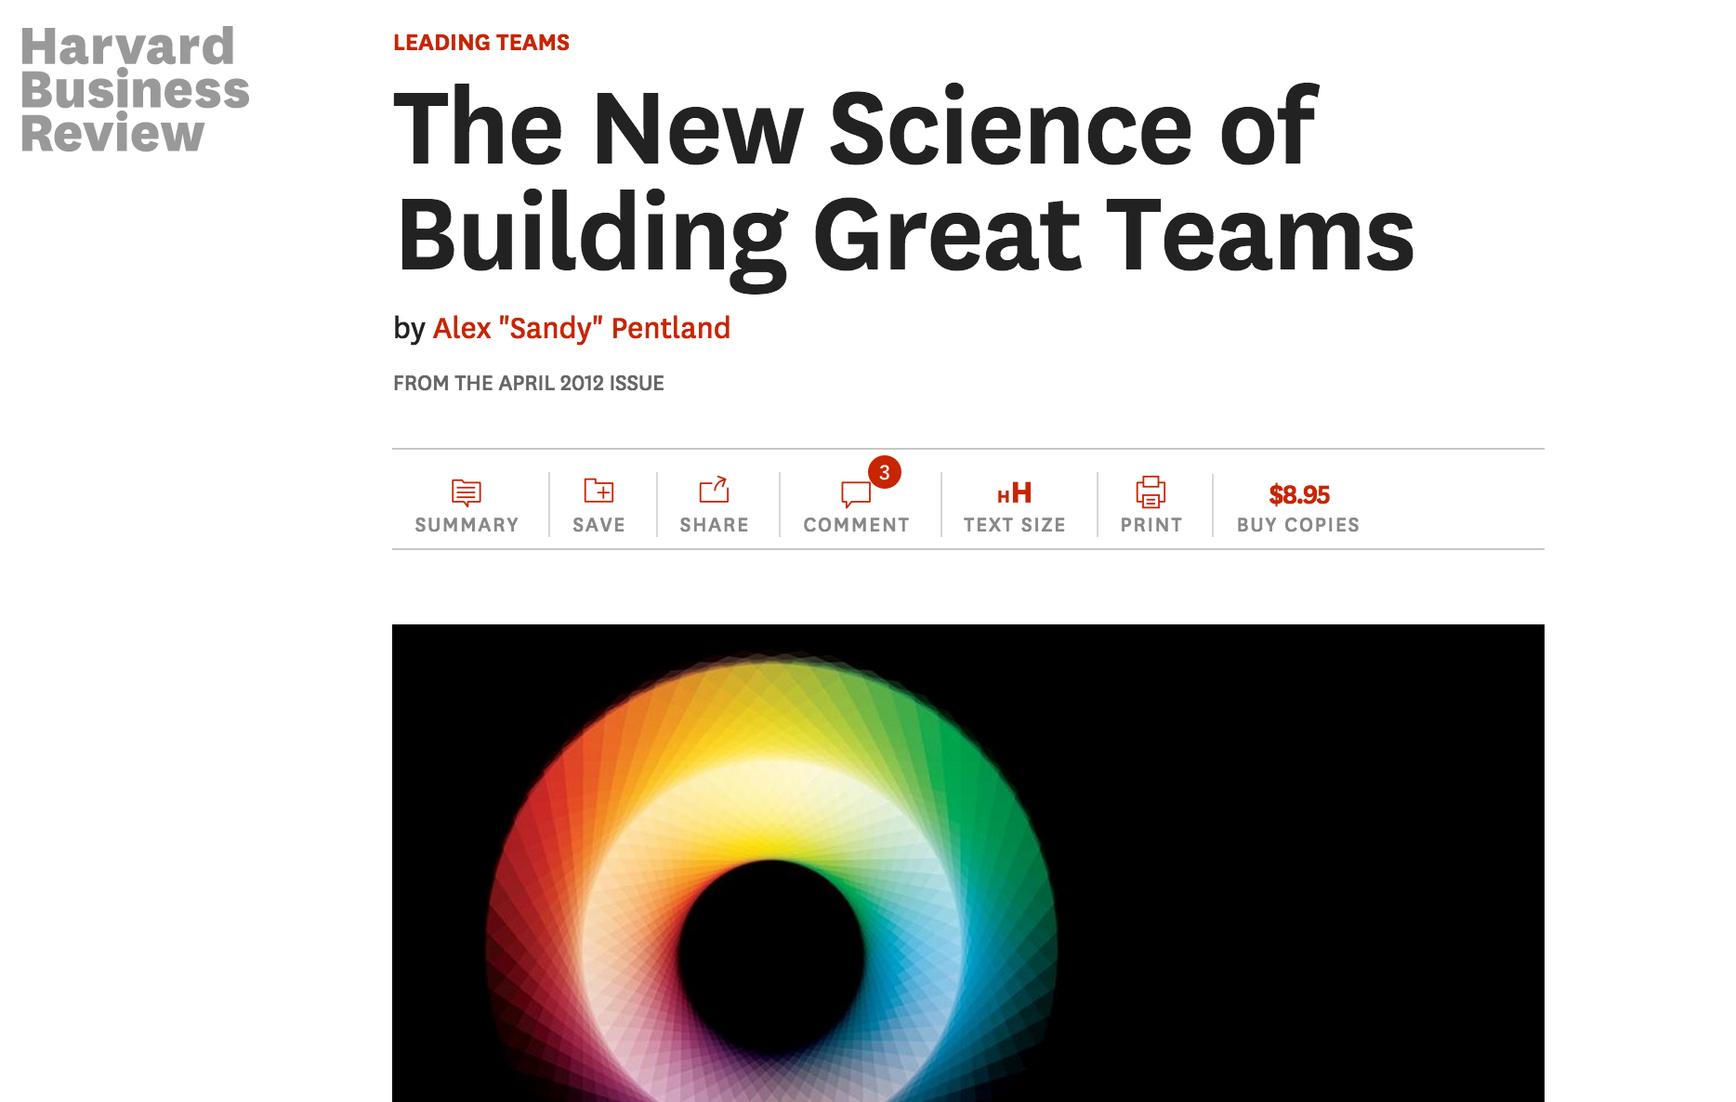
https://hbr.org/2012/04/the-new-science-of-building-great-teams

Slide 4
Lack of empowerment
Understand both sides
Take the heat
Provide internal support

Slide 5
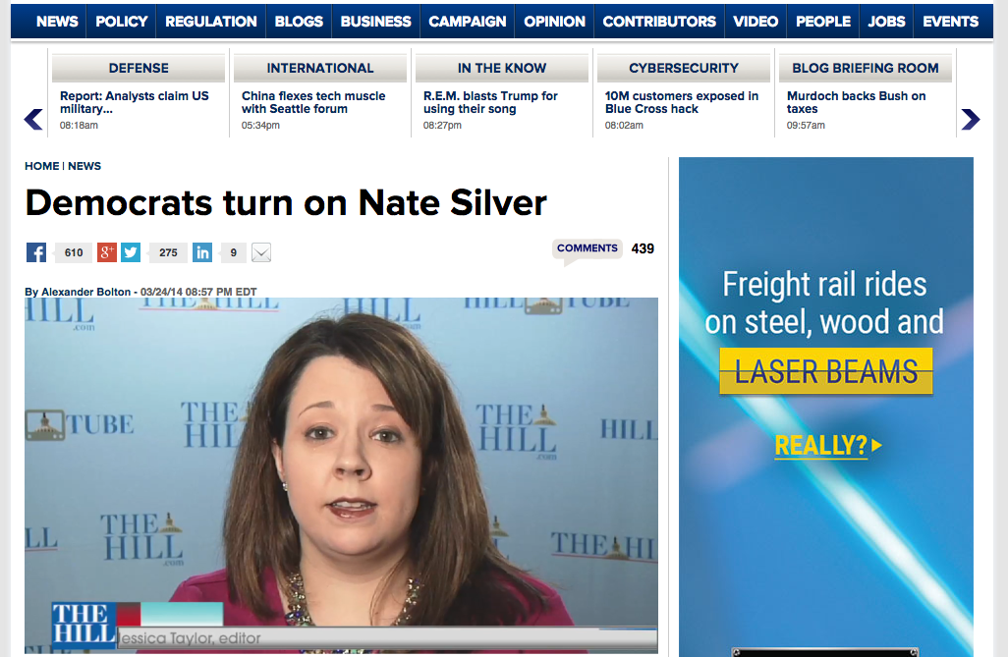
http://thehill.com/homenews/news/201595-democrats-turn-on-nate-silver

Slide 6
Lack of understanding
More interactions with other groups
Presentations to the organization
Advertising the data team

Slide 7
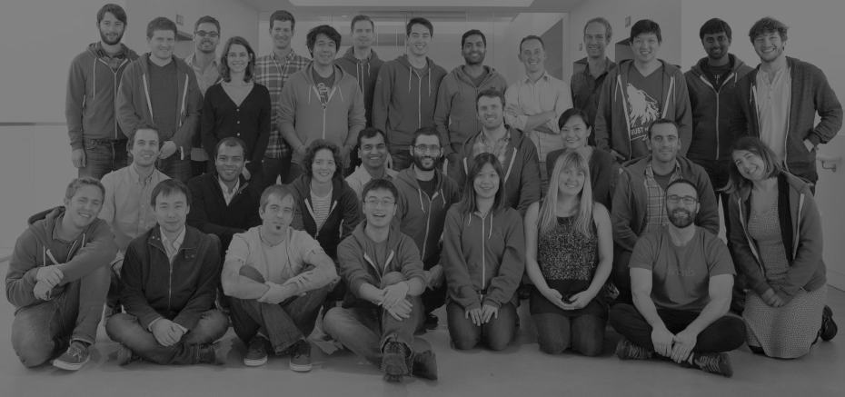
“
Over time, our colleagues on other teams have come to understand that the data team isn’t a bunch of Vulcans, but rather that we represent the very human voices of our customers. This has paved the way for changes to the structure of data science at Airbnb.
”
-Riley Newman, AirBnB
Source: http://bit.ly/1OEvdk4
Image: http://bit.ly/1K0xy7Y

